Slide 1
Integrating Study Habits, Extracurricular Activities, and Parental Information for GPA Classification
GPA Genie:
Dhruv Chandna & Soham Jain
Dr. Yilmaz Period 1
TJ Machine Learning 1
10/23/2024
Notes:
D

Slide 2
Project Overview
Tool for students to optimize academic and extracurricular planning from an early age
Enables students to weigh different study habits and activities to maximize academic success
Our goal is to predict high school students’ GPA by examining relevant factors that can shape their educational outcomes
Notes:
D

Slide 3
DATASET

Slide 4
Descriptive Attributes
Students Performance Dataset
Contains demographics, study habits, and extracurricular information for 2,392 high school students
Target is GradeClass, a quantitative discrete variable for GPA classification:
0: GPA >= 3.5
1: 3.0 <= GPA < 3.5
2: 2.5 <= GPA < 3.0
3: 2.0 <= GPA < 2.5
4: GPA < 2.0
Notes:
D

Slide 5
Attributes
ParentalSupport (self-evaluated)
0: None
1: Low
2: Moderate
3: High
4: Very High
Extracurricular
0: No participation
1: Participation
Sports
0: Does not play sport
1: Plays sport
Music
0: No music activities
1: Music activities
Volunteering
0: No music activities
1: Music activities
GPA (2.0-4.0)
Students Performance Dataset contains 14 attributes
Student ID (1001-3392)
Age (15-18)
Gender
0: Male
1: Female
Ethnicity
0: Caucasian
1: African American
2: Asian
3: Other
ParentalEducation
0: None
1: High School
2: Some College
3: Bachelor's
4: Higher
StudyTimeWeekly (0.0-20.0)
Study time in hours
Absences (0-30)
Tutoring
0: No tutoring
1: Receives tutoring
Notes:
D

Slide 6
PREPROCESSING

Slide 7
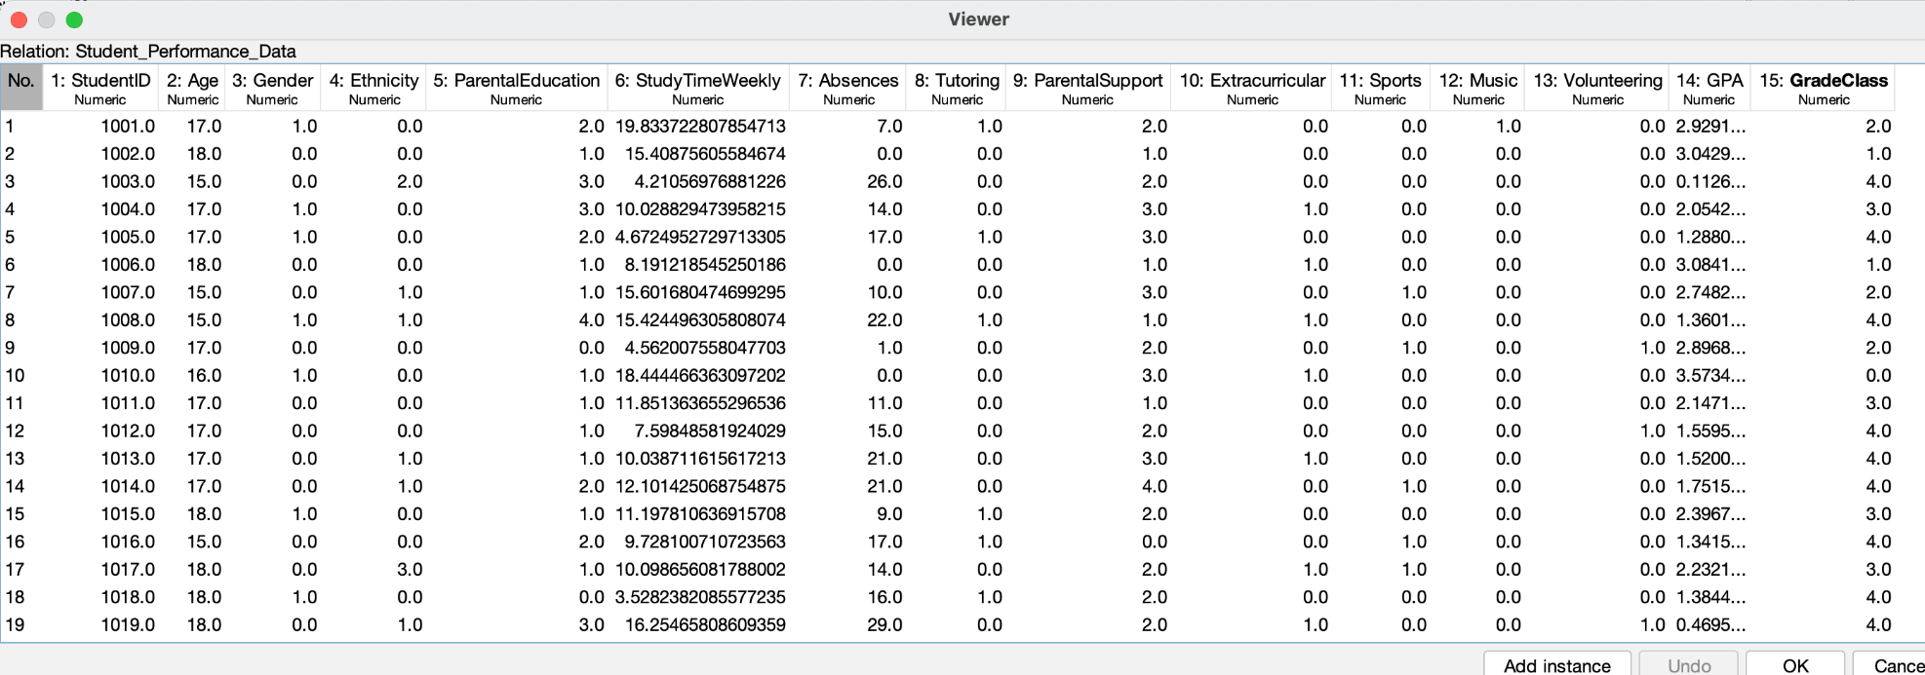
Data Cleaning
We removed the StudentID and GPA attributes
Student ID - no predictive power
GPA - class variable is just GPA discretized
Notes:
D

Slide 8
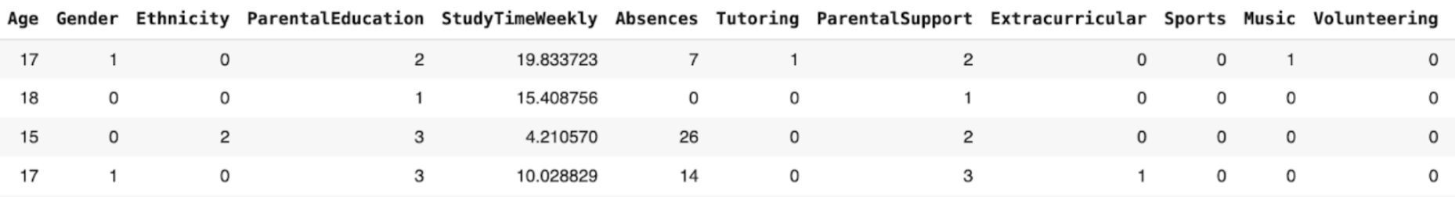
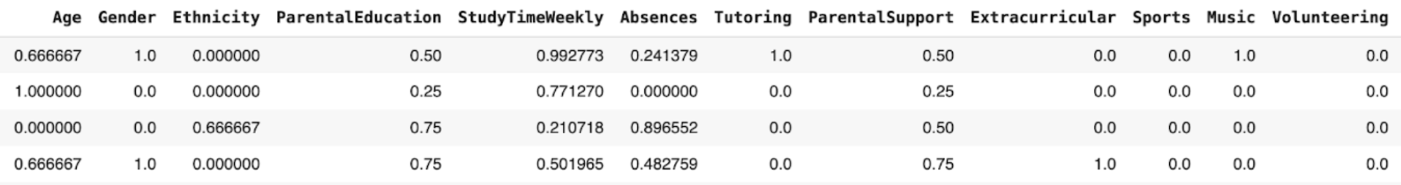
Normalization
Min max normalization to ensure all values range between 0 and 1
Before:
After:
Notes:
S

Slide 9
ATTRIBUTE SELECTION

Slide 10
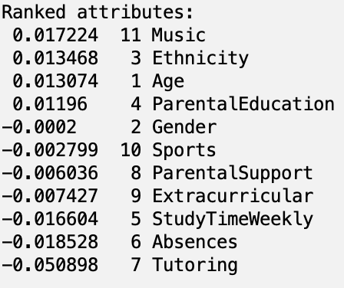
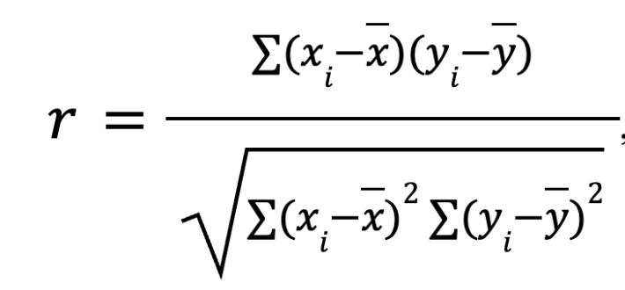
Method 1: Ranker + CorrelationAttributeEval
Threshold: 0.01
Features:
Music, Ethnicity, Age, ParentalEducation, StudyTimeWeekly, Absences, Tutoring
Notes:
S

Slide 11
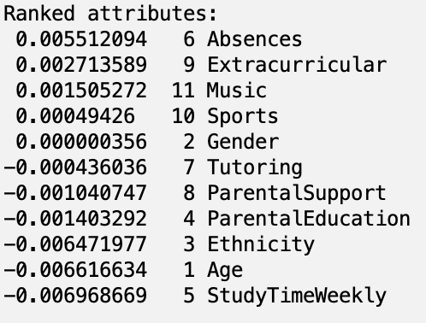
Method 2: Ranker + ReliefFAttributeEval
Threshold: 0.0015
Features:
Absences, Extracurricular, Music, Ethnicity, Age, StudyTimeWeekly
Evaluates attributes by sampling an instance and the value for the nearest instance of the same and different class
Notes:
S

Slide 12
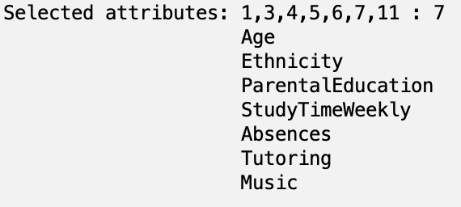
Method 3: GreedyStepwise + CfsSubsetEval
Threshold: N/A
Features:
Age, Ethnicity, ParentalEducation, StudyTimeWeekly, Absences, Tutoring, Music
Creates a subset of features that are highly correlated with the class while having low redundancy between them.
Notes:
S

Slide 13
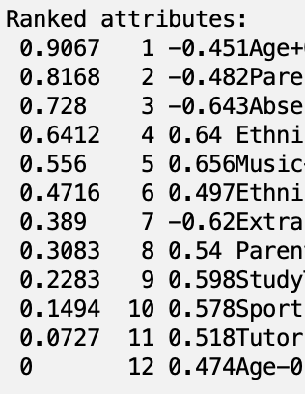
Method 4: Ranker + PrincipalComponents
Threshold: 0.7
Features:
PCA1 -0.451A+0.451T-0.365G-0.339V-0.31M
PCA2 -0.482PS-0.478STW-0.368T+0.305PE+0.295V
PCA3 -0.643A-0.471S-0.327STW-0.299PE-0.246G
Age, Tutoring, Gender, Volunteering, Music, ParentalSupport, StudyTimeWeekly, ParentalEducation, Sports
Notes:
S

Slide 14
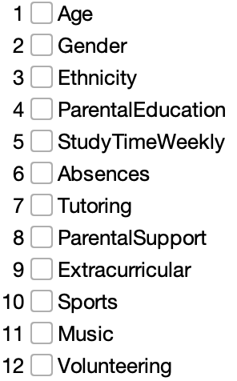
Method 5: AllRetained
Threshold: N/A
Features:
Age, Gender, Ethnicity, ParentalEducation, StudyTimeWeekly, Absences, Tutoring, ParentalSupport, Extracurricular, Sport, Music, Volunteering
Notes:
S

Slide 15
TRAIN-VALIDATION-TEST SPLIT

Slide 16
Train-Validation-Test Split
First, we mapped class values from quantitative to qualitative variables for classification
Then, we used the train_test_split method from scikit-learn with the ‘stratify’ parameter to ensure class distributions accurately reflected the original dataset
Notes:
D

Slide 17
CLASSIFIERS

Slide 18
Classifiers
Logistic
Statistical model that uses a logistic function to map predicted values to probabilities, allowing for class predictions
MultilayerPerceptron
Neural network that processes input data through hidden layers to produce class predictions
Bagging
Ensemble learning method that combines predictions from multiple models trained on random subsets
Logistic Model Trees (LMT)
Combines decision trees with logistic regression for classification
Notes:
S

Slide 19
RESULTS & DISCUSSION

Slide 20
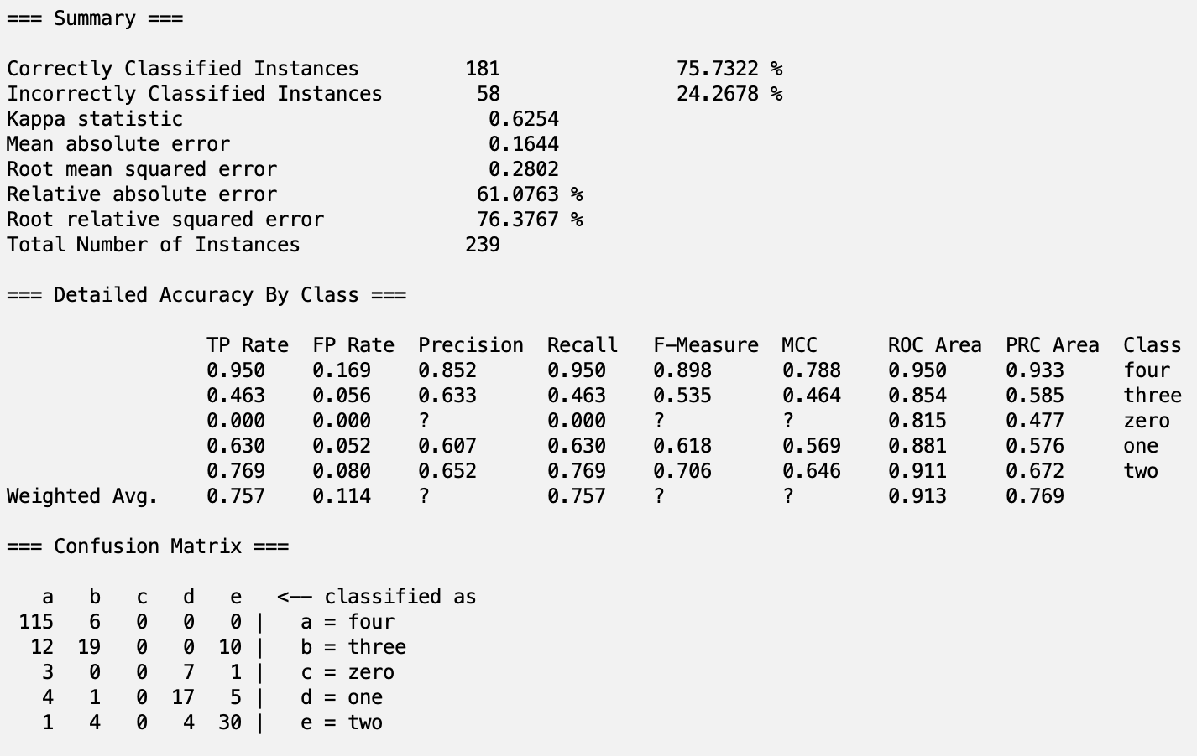
Highest Accuracy
Achieved highest accuracy with Logistic classifier and AllRetained attribute selection
Accuracy: 75.7%
Recall: 0.757
Precision: 0.869
AUC: 0.913
F1-score: 0.809
Notes:
S

Slide 21
Confusion Matrix
Predicted
0
1
2
3
4
0
0
7
1
0
3
1
0
17
5
1
4
Actual
2
0
4
30
4
1
3
0
0
10
19
12
4
0
0
0
6
115
Notes:
S

Slide 22
Analysis
Logistic model captured predictive relationships between input features and the categorical target variable
Small input volume made AllRetained optimal attribute selection method
Confounding variables (i.e. school, state, etc.) taint results
Notes:
D

Slide 23
CONCLUSION

Slide 24
Conclusion & Future Work
Incorporate features like socioeconomic status, school, sleep patterns, etc.
Hyperparameter tuning to optimize performance
Explore tailored frameworks using Google Colab/Jupyter
Notes:
S

Slide 25
Thanks!
Any Questions?

